Slide 1
WELCOME

Slide 2
SMART AUTOMATION USING MACHINE LEARNING ALGORITHMS AND NEURAL INTERFACE
Guided by,
Ms.Shabna. M
Asst. Prof
Dept. Of CSE
MGM college of engineering & pharmaceutical sciences
Valanchery
Presented By,
Akshay Sankar
Hafeed K
Minhaj Fasalu

Slide 3
CONTENTS
INTRODUCTION
OBJECTIVE
LITERATURE SURVEY
EXISTING SYSTEM
PROPOSED SYSTEM
SYSTEM ARCHITECTURE
DESIGN DIAGRAM
REQUIREMENTS
MODULES
RESULT ANALYSIS
CONCLUSION
REFERENCES
12-07-2021

Slide 4
INTRODUCTION
Smart Home Systems are the subset of everyday computing.
When this application is controlled by machine intelligence to provide circumstance-aware settings.
Here we define an improved Home automation system using multiple machine learning algorithms

Slide 5
OBJECTIVE
To bring Strict Power Control and Save Energy
To Achieve an intelligent control system
To Bring Down the Manual Setting to Zero With Intelligent Control

Slide 6
LITERATURE SURVEY
NO | PAPER | ADVANTAGES | DISADVANTAGES
1 | Smart Energy Efficient Home Automation System Using IoT | Less Manual Control | Only Have A Web Based Control No Learning System
2 | i-learning IoT: An intelligent self learning system for home automation using IoT | Less Manual Control Learning System | Uses Less Accurate Learning Algorithm
3 | Enhanced Smart Home Automation System based on Internet of Things | Less Manual Control App Based System Can Controlled By Anywhere In The World | Not A Learning System Does Not Have Web Capability
Table No:-1

Slide 7
LITERATURE SURVEY
NO | PAPERS | ADVANTAGES | DISADVANTAGES
4 | Enabling IoT automation using local clouds | Less Manual Control Wide range of IOT Device Capabilities APP AND WEB Based | Internet Is Requirement For Connecting More Device Inoperability
5 | Smart Automation using Machine Learning Algorithms | No Manual Control Required No App or Web Based Apps Required Complete Learning System Facial Recognition Internet Is Not A Mandatory | User Must Depend On Some Manual Control Until System Learns User Pattern
Table No:-2

Slide 8
EXISTING SYSTEM
Traditional home automation systems that provide only remote access and control
They are not that effective in terms of being ‘smart’
Has Lot of Manual Control
Need an interface for operation
Not Efficient

Slide 9
PROPOSED SYSTEM – Emotion Recognition Mode
Proposed System Uses Haarcascade Classifier
By using Supervised Learning, the Classifier categorizes new examples.
To use Haarcascade to recognize facial expression, we extract facial landmark key points first and then it is given to Haarcasacade classifier to detect user’s mood

Slide 10
PROPOSED SYSTEM – Emotion Recognition Mode
To detect the landmarks that are crucial points required for identifying the emotions/expressions, we use DLib library
Normalization of key-points is done by calculating the mean of x and y axes which gives us the coordinates for center of gravity in all facial landmarks.
DLib Library file help to identify eyes,lips,nose,etc attributes on face

Slide 11
PROPOSED SYSTEM – Neural Interface Mode
Proposed Mode Uses EEG(Electro Encephalograph) sensor to detect beta waves from brain
These waves are transmitted over Bluetooth or Wi-Fi to Our system for processing
According to wave pattern respective profiles are switched

Slide 12
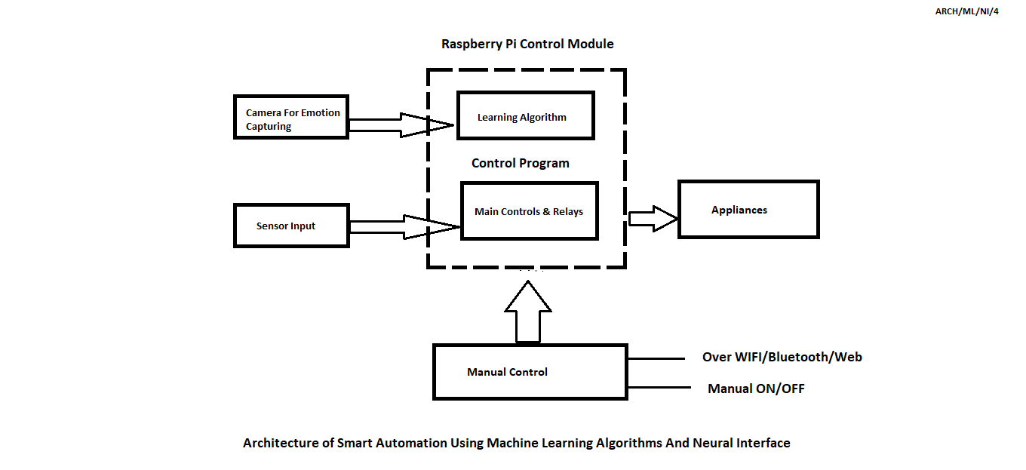
SYSTEM ARCHITECTURE
Fig No:- 1

Slide 13
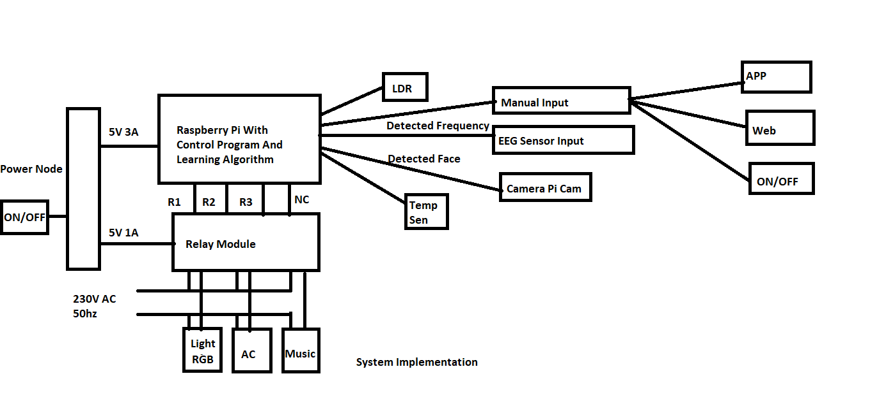
DESIGN DIAGRAM
Fig No:- 2

Slide 14
REQUIREMENTS
Hardware
Raspberry Pi
Node MCU
Arduino
Graphic Card (Nvidia Geforce GTX 1060 6gb VRAM)
Relay 5V || 230V 10A x 4
WebCam
EEG/ECG Sensor
Temperature sensor, LDR, Humidity Sensor

Slide 15
REQUIREMENTS
Software
PyCharm
OpenCV
Keras
Aurduino IDE
Processing
Services Required
Git
IFTTT

Slide 16
MODULE I – EMOTION RECOGNITION MODE
Connected Webcam is used to detect emotion
Face and facial landmarks are used to identify emotion
According to emotion profiles are switched
Each profile contain different tasks

Slide 17
MODULE II – NEURAL INTERFACE MODE
Uses EEG Sensor to Interface with Brain to Carry brain wave signals to raspberry
Modulation of waves carries different instruction to raspberry pi to perform different tasks
EEG sensor is tuned to detect beta waves which deals with consciousness
According to wave modulation profiles are switched

Slide 18
Result Analysis - Module I
The face has been detected.
The landmarks have been plotted successfully.
The system is able to identify the type of emotion on the users face.

Slide 19
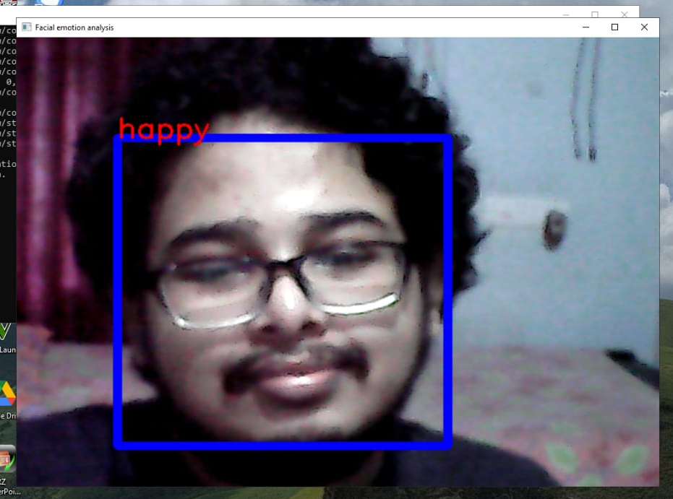
Result Analysis – Module I
Fig No:- 3

Slide 20
Result Analysis - Module II
The proposed system is able to detect the beta waves from the brain
The values are matched with predefined values in the system
The system then automates the required tasks

Slide 21
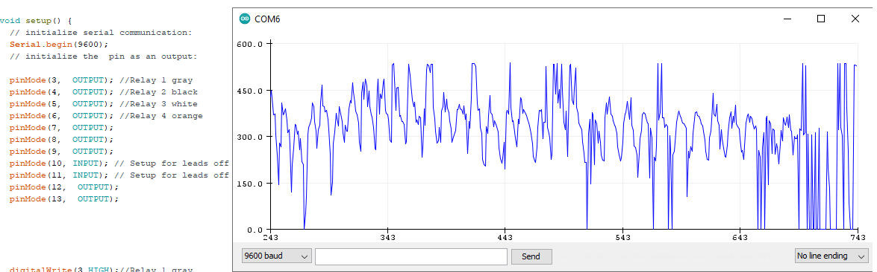
Result Analysis - Module II
Fig No:- 4 Attention Level Graph From ECG Sensor
12-07-2021

Slide 22
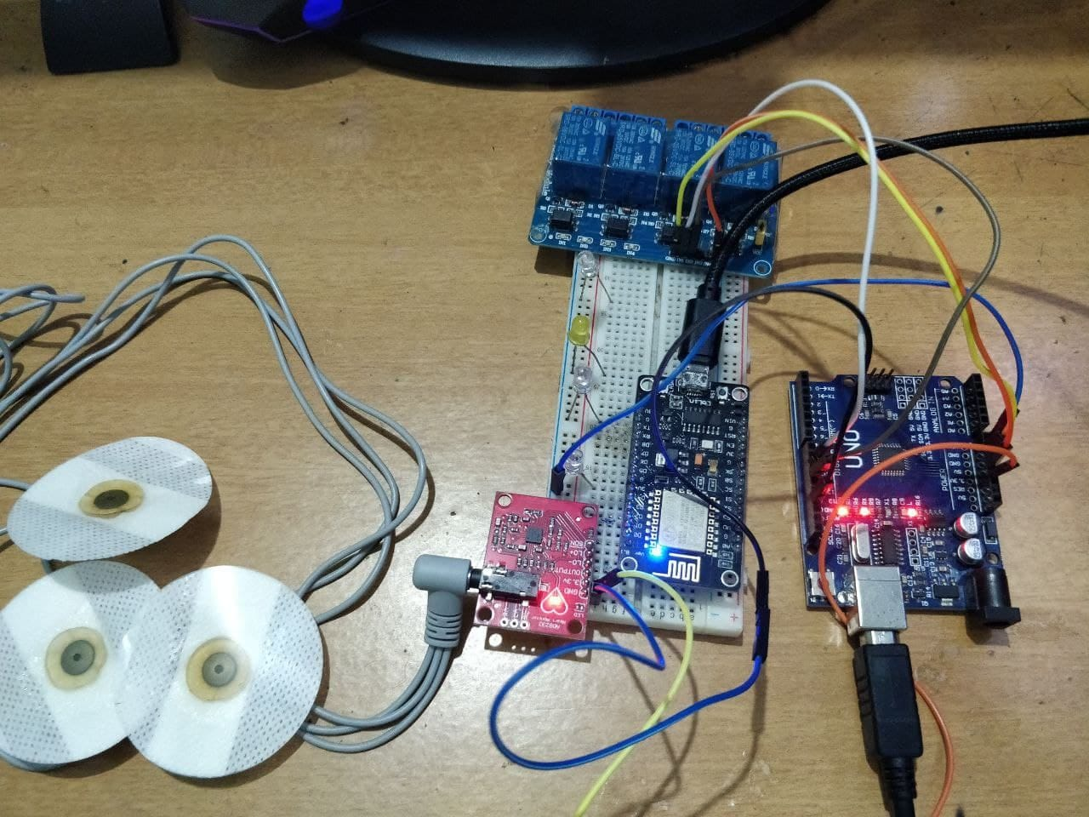
Setup
Fig No:- 5

Slide 23
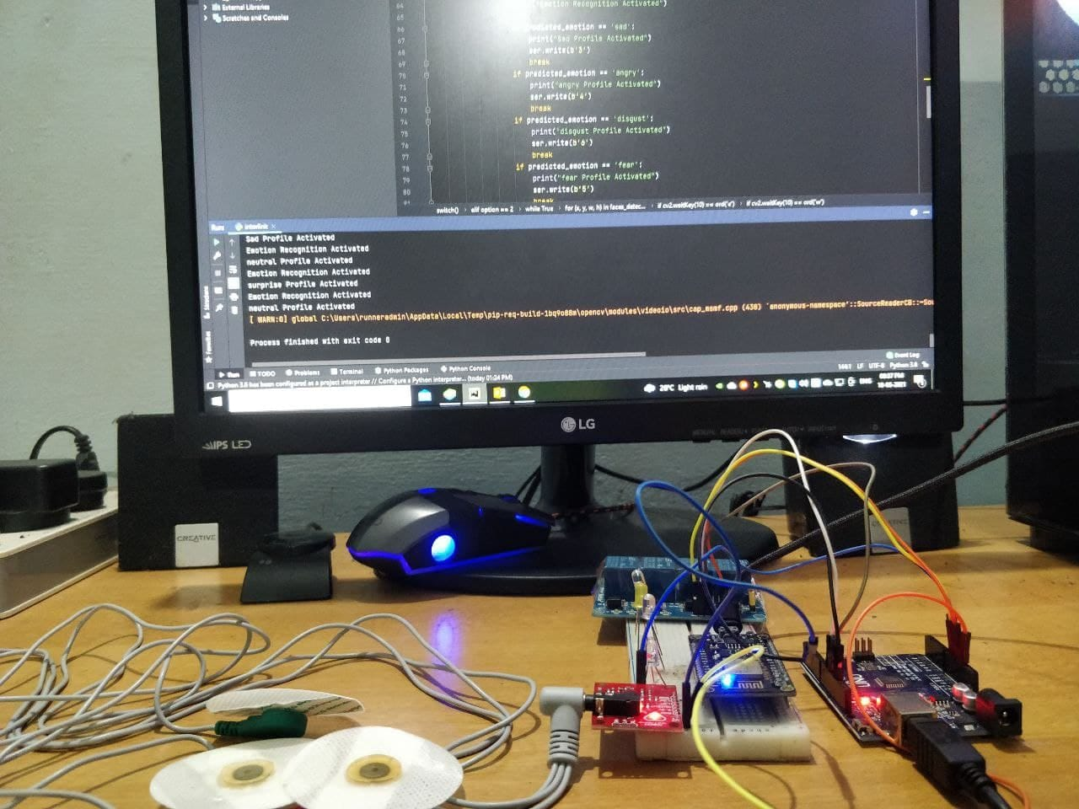
Setup
Fig No:- 6

Slide 24
CONCLUSION & FUTURE SCOPE
An Intelligent System that controls Usage of Electricity
Easiness & Comfort to Users
Manual Control is brought to Zero
Future Applications
Neural Interface
BrainWave Controlled Video Editing Using Macros
Automation Solution
BrainWave Computing
Gesture Controlled Automation

Slide 25
REFERENCES
Minaee S, Abdolrashidi Minaee, Shervin, and Amirali Abdolrashidi. ”Deep-Emotion: Facial Expression Recognition Using Attentional Convolutional Network.” arXiv preprint arXiv:1902.01019 (2019).
https://www.youtube.com/watch?v=DtBu1u5aBsc – Emotion Recognition Training.
Stack Overflow
Hackster.io
https://neuralink.com/

Slide 26
THANK YOU

